Slide 1



Tema 10
El Código Genético
CA García Sepúlveda MD PhD
Last updated Jan 2019
Laboratorio de Genómica Viral y Humana
Facultad de Medicina, Universidad Autónoma de San Luis Potosí

Slide 2
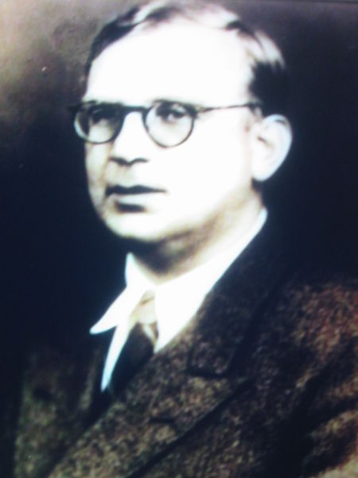

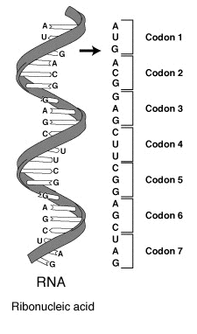
Tema 10. El Código Genético
Introducción
The genetic code is the set of rules by which information encoded in DNA or RNA is translated into proteins.
Mapping between tri-nucleotide sequences (codons) and amino acids.
Every triplet of nucleotides in a nucleic acid sequence specifies a single amino acid.
Georgiy Antonovich Gamow (1904 – 1968).
Russian-empire born theoretical physicist and cosmologist that also discovered alpha decay
Worked on radioactive decay of the atomic nucleus, star formation, stellar nucleosynthesis, big bang nucleosynthesis, nucleocosmogenesis and genetics.
Proposed a system known as "Gamow's diamonds" that consisted of an overlapping, nondegenerate code.
Francis Crick based his work on Gamow's theoretical background.

Slide 3
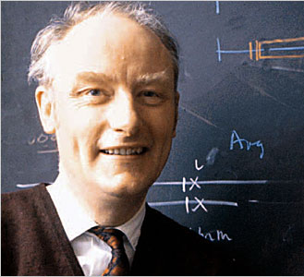
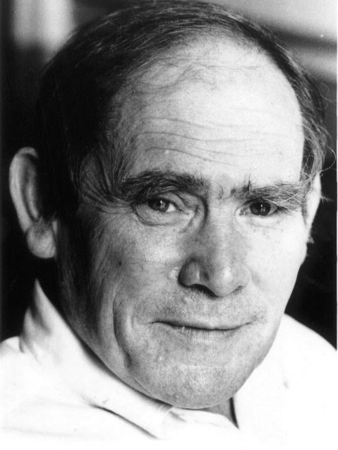
Tema 10. El Código Genético
History
That codons did consist of three DNA bases was first demonstrated in the Crick- Brenner experiment (1961).
The experiment elucidated the nature of gene expression and frameshift mutations.
Proflavin-induced mutations of the T4 bacteriophage gene, rIIB, were induced (causes indels by intercalation).
Mutants with 1, 2 or 4 indels did not produce rIIB (frameshifts).
Mutants with 3 indels (or multiples) did produce rIIB (albeit anomalous).

Slide 4
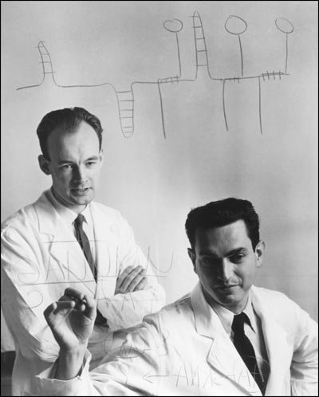
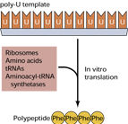
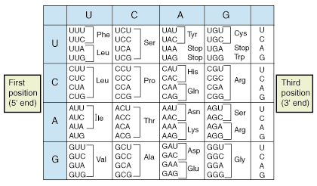
Tema 10. El Código Genético
History
The first elucidation of a codon was done by Marshall Nirenberg & Heinrich J. Matthaei in 1961 at the National Institutes of Health.
Used a cell-free system to translate a poly-uracil RNA sequence to a phenylalanine repeat peptide.
Deduced that UUU = phenylalanine.
Extending this work, Nirenberg & Matthaei determined the nucleotide makeup of each codon.

Slide 5
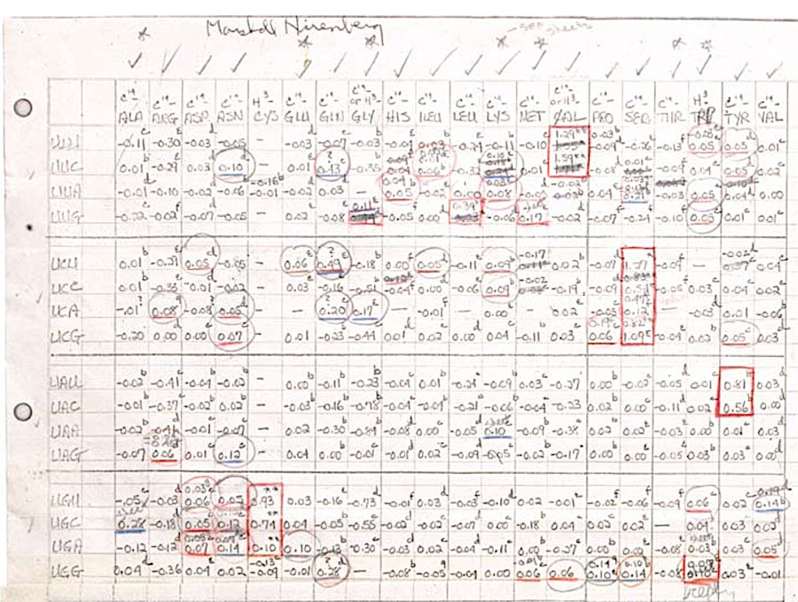
Tema 10. El Código Genético
History
Marshall’s Study Notes (1961)

Slide 6
Tema 10. El Código Genético
Código canónico
Canonical Genetic Code
From the codon perspective
Interpretation based on codon sequence
A

Slide 7
Tema 10. El Código Genético
Código canónico
Canonical Genetic Code
From the codon perspective
Interpretation based on codon sequenc
A
U

Slide 8
Tema 10. El Código Genético
Código canónico
Canonical Genetic Code
From the codon perspective
Interpretation based on codon sequence
A
U
G

Slide 9
Tema 10. El Código Genético
Códigos alternativos
Slight variations on the canonical code had been predicted
Alternative codes were discovered in 1979, in human mitochondria.
Many alternative mitochondrial codes now known.
Mycoplasma variants translate UGA as tryptophan.
In bacteria and archaea, GUG and UUG are common start codons.
In rare cases, certain specific proteins may use alternative initiation (start) codons
not normally used by that species.

Slide 10
Tema 10. El Código Genético
Códigos alternativos
In certain proteins, non-standard amino acids are encoded for by standard stop codons.
UGA = Selenocysteine (21st)
UAG = Pyrrolysine (22nd)
Depend on associated signal sequences in the mRNA.

Slide 11
Tema 10. El Código Genético
Códigos alternativos
A detailed description of variations in the genetic code can be found at NCBI.

Slide 12
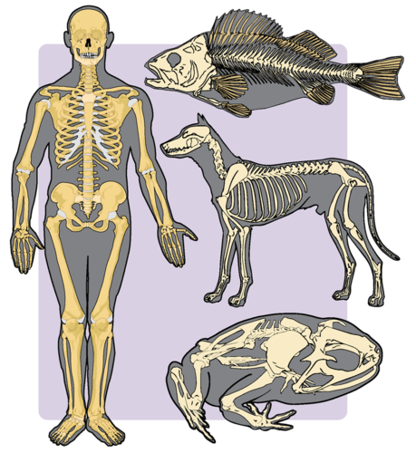
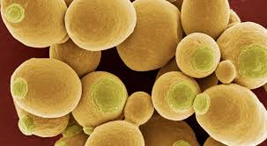
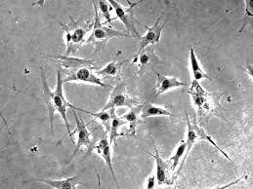
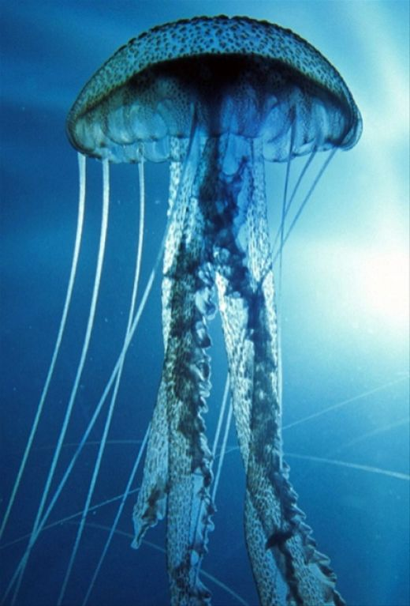
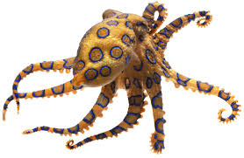
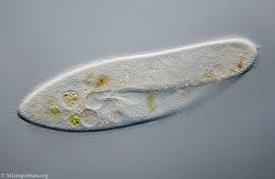
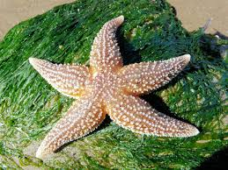
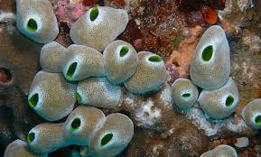
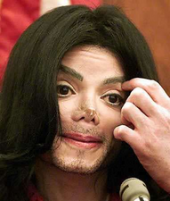
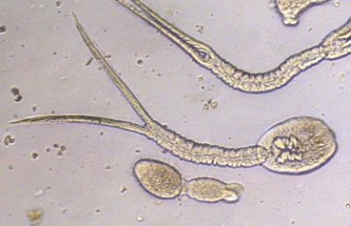
Tema 10. El Código Genético
Alternative Genetic Codes
The Standard Code
The Vertebrate Mitochondrial Code
The Yeast Mitochondrial Code
The Mold, Protozoan & Coelenterate Mitochondrial Code
The Mycoplasma/Spiroplasma Code
The Invertebrate Mitochondrial Code
The Ciliate, Dasycladacean and Hexamita Nuclear Code
The Echinoderm and Flatworm Mitochondrial Code
The Euplotid Nuclear Code
The Bacterial and Plant Plastid Code
The Alternative Yeast Nuclear Code
The Ascidian Mitochondrial Code
The Alternative Flatworm Mitochondrial Code
Blepharisma Nuclear Code
Chlorophycean Mitochondrial Code
Trematode Mitochondrial Code
Scenedesmus Obliquus Mitochondrial Code
Thraustochytrium Mitochondrial Code
The Michael Jackson Code

Slide 13
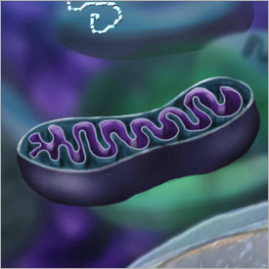
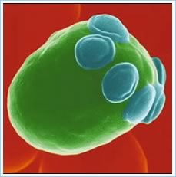
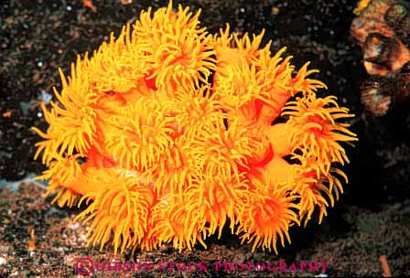
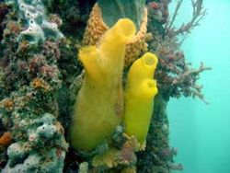
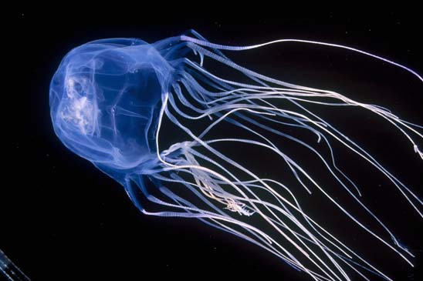
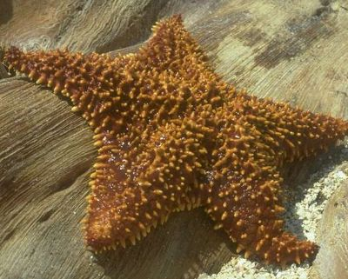
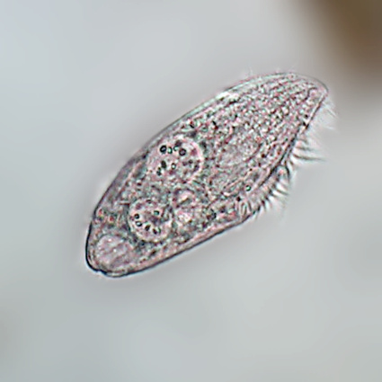
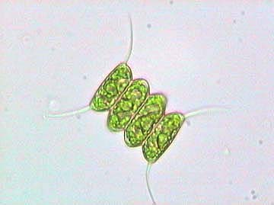
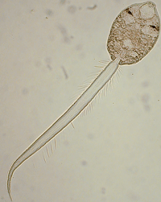
Tema 10. El Código Genético
Alternative Genetic Codes
However, all known codes have strong similarities and the coding mechanism is the same for all organisms:
  three-base codons
  tRNA & ribosomes
  read the code in the same direction
  translating the code by codons
Even Michael’s !

Slide 14
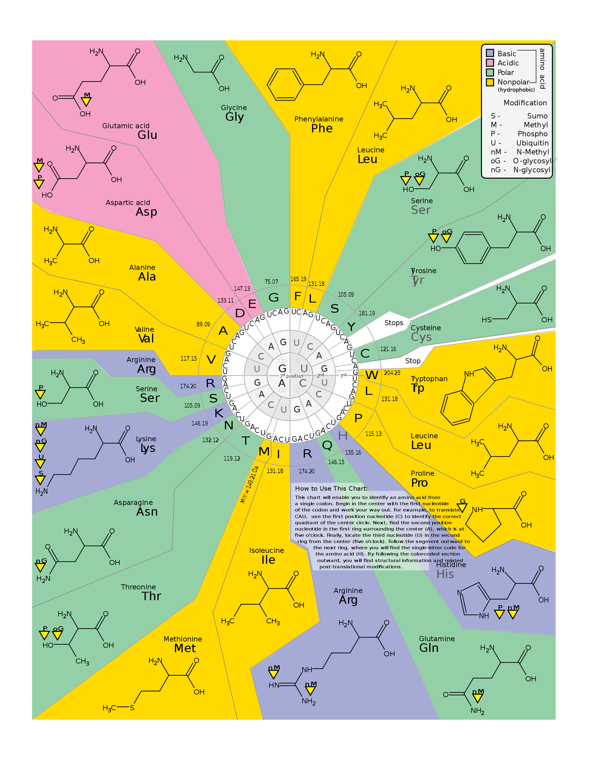
Tema 10. El Código Genético
Properties
Current state
Chemical properties
Basic
Acidic
Polar
Non-polar
http://en.wikipedia.org/wiki/File:GeneticCode21-version-2.svg

Slide 15
Tema 10. El Código Genético
Modifications
Current state
Modifications
S - Sumolation
M - Methylation
P - Phosphorylation
U - Ubiquitination
nM - N-Methylation
oG - O-Glycosylation
nG - N-Glycosylation

Slide 16
Tema 10. El Código Genético
Degeneracy
Code is degenerate:
ACC
ACG
ACU
ACA
Which means that the third bases is relatively free to mutate or allowed a wider degree of evolutionary freedom !
Thr

Slide 17
Tema 10. El Código Genético
Degeneracy (4x)
A position of a codon is said to be a fourfold degenerate site if any nucleotide at this position specifies the same amino acid.
For example, the third position of the glycine codons (GGA, GGG, GGC, GGU) is a fourfold degenerate site = all nucleotide substitutions at this site are synonymous.
Only the third positions of some codons may be fourfold degenerate.

Slide 18
Tema 10. El Código Genético
Degeneracy (2x)
A position of a codon is said to be a twofold degenerate site if only two of four possible nucleotides at this position specify the same amino acid.
I.E. glutamic acid codons.
In twofold degenerate sites, the equivalent nucleotides are always either two purines (A/G) or two pyrimidines (C/U) = transicional substitutions.
Transversions are NS

Slide 19
Tema 10. El Código Genético
Degeneracy (3x)
There is only one possible threefold degenerate site.
Where changing three of the four nucleotides has no effect on the amino acid, while changing the fourth possible nucleotide results in a NS substitution.
This is the case of Ile codon: AUU, AUC, or AUA all encode isoleucine, but AUG encodes methionine.

Slide 20
Tema 10. El Código Genético
Degeneracy
A position of a codon is said to be a non-degenerate site if any mutation at this position results in amino acid substitution.

Slide 21
Tema 10. El Código Genético
Redundancy and ambiguity
The genetic code has redundancy (degeneracy) but no ambiguity.
Redundancy: Different codons code for the same amino acid.
  GAA & GAG both code for Glutamic Acid (redundant) but DO NOT code for any other amino acid (Ambiguity).
Codon differences may fall in any position:
  GAA & GAG = Glutamic Acid (difference in 3rd position).
  UUA, UUG, CUU, CUC, CUA & CUG = Leucine (1st & 3rd).
  UCA, UCG, UCC, UCU, AGU & AGC = Serine (1st, 2nd & 3rd ).

Slide 22
Tema 10. El Código Genético
Redundancy
REDUNDANCY
Only three amino acids are encoded by six different codons: serine, leucine, arginine.

Slide 23
Tema 10. El Código Genético
Redundancy
REDUNDANCY
Only three amino acids are encoded by six different codons: serine, leucine, arginine.

Slide 24
Tema 10. El Código Genético
Redundancy
REDUNDANCY
Only three amino acids are encoded by six different codons: serine, leucine, arginine.

Slide 25
Tema 10. El Código Genético
Redundancy
REDUNDANCY
A practical consequence of redundancy is that some errors in the genetic code only cause a silent mutation or an error that would not affect the protein because the hydrophobicity is maintained by equivalent substitution of amino acids.
For example, a codon of NUN (where N = any nucleotide) tends to code for hydrophobic amino acids.

Slide 26
Tema 10. El Código Genético
Single codon amino acids
Only two amino acids are specified by a single codon.
Methionine, specified by the codon AUG, which also specifies the start of translation.
Tryptophan, specified by the codon UGG.

Slide 27
Tema 10. El Código Genético
Conserving chemical properties
Also, most second and third site non-synonymous substitutions lead to “conserved” chemical properties.
UCn - Ser
UAn - Tyr Polar
UGU/C - Cys

Slide 28
Tema 10. El Código Genético
Codon usage
There are 4³ = 64 different codon combinations possible with a triplet codon of three nucleotides.
4x4x4 = 64
All 64 codons of the canonical genetic code are assigned to either amino acids or stop signals during translation.

Slide 29
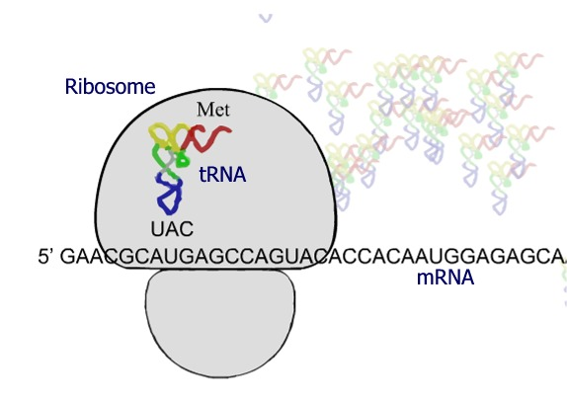
Tema 10. El Código Genético
Start Codons
Translation starts with a chain initiation codon (start codon AUG).
Unlike stop codons, the start codon alone is not sufficient to begin the process.
Nearby sequences and initiation factors are also required to start translation.
The most common start codon is AUG, which codes for methionine, so most amino acid chains start with methionine.

Slide 30
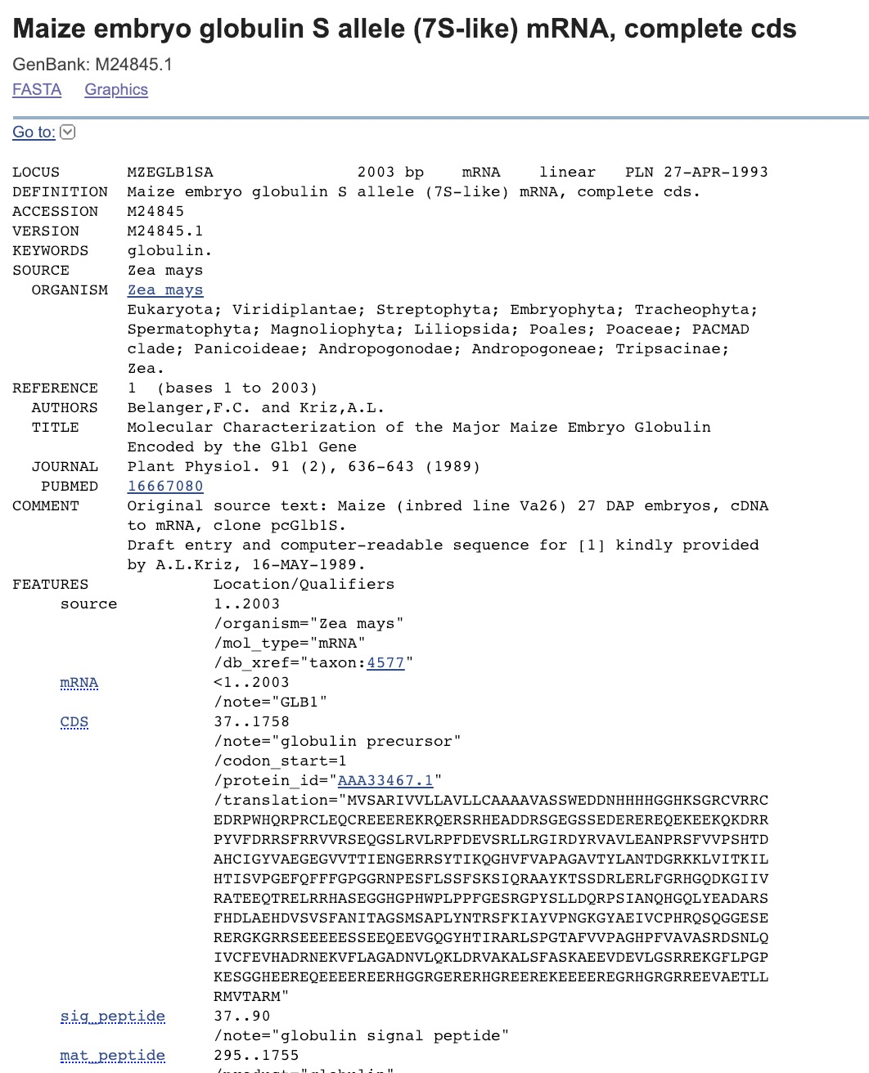
Tema 10. El Código Genético
Start Codons

Slide 31
Tema 10. El Código Genético
Stop Codons
There are three known stop codons which have been given names:
  UAG is amber
  UGA is opal (also called umber)
  UAA is ochre
Also called termination codons.
Do not have tRNA anti-codons, instead they bind release factors.
They signal release of the nascent polypeptide from the ribosome due to binding of release factors.
Suffice termination.

