Slide 1
Tema 11
Traducción
CA García Sepúlveda MD PhD
Last updated Jan 2019
Laboratorio de Genómica Viral y Humana Facultad de Medicina, Universidad Autónoma de San Luis Potosí

Slide 2
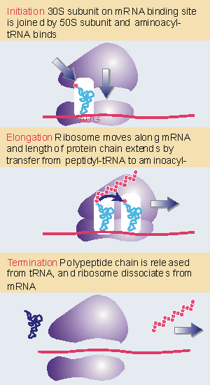
Tema 11. Traducción Etapas de la traducción
Protein synthesis divided into the three stages:
1.- Initiation
2.- Elongation
3.- Termination

Slide 3
Tema 11. Traducción Etapas de la traducción
Initiation involves the reactions that precede formation of the peptide bond between the first two amino acids of the protein.
It requires the ribosome to bind to the mRNA, forming an initiation complex that contains the first aminoacyl-tRNA.
This is a relatively slow step in protein synthesis, and usually determines the rate at which an mRNA is translated.

Slide 4
Tema 11. Traducción Etapas de la traducción
Elongation includes all the reactions from synthesis of the first peptide bond to addition of the last amino acid.
Amino acids are added to the chain one at a time.
This is the most rapid step in protein synthesis.

Slide 5
Tema 11. Traducción Etapas de la traducción
Termination encompasses the steps that are needed to release the completed polypeptide chain and dissociate the ribosome from the mRNA.

Slide 6
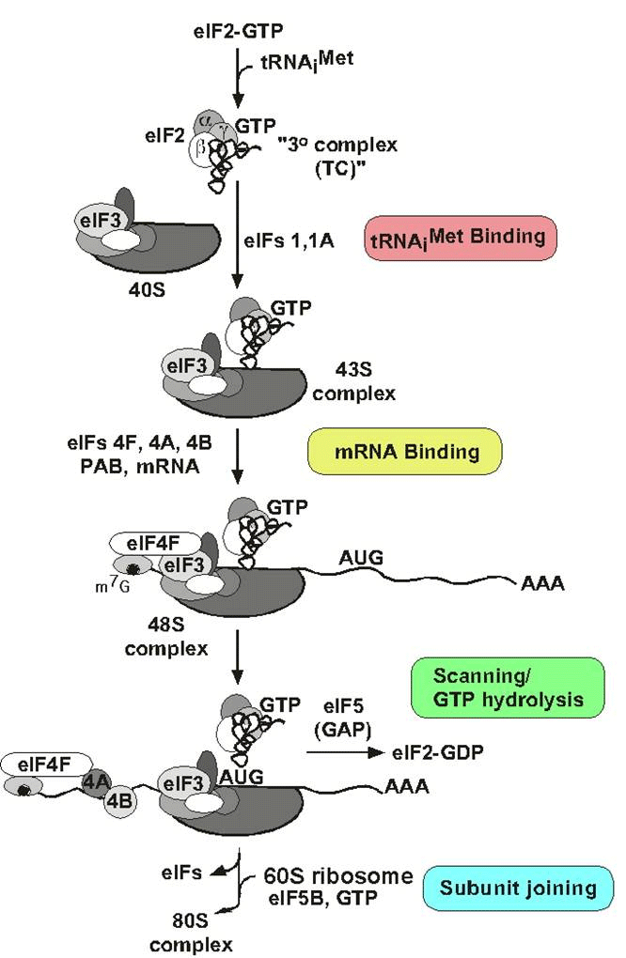
Tema 11. Traducción Factores accesorios
Different sets of accessory factors assist the ribosome at each stage.
Energy is provided at various stages by the hydrolysis of GTP.
Accessory factors are not covalently linked to Ribosome (proteins or RNA).

Slide 7
Tema 11. Traducción Factores accesorios
Initiation in bacteria needs 30S subunits and accessory factors
Initiation factors (IF in prokaryotes, eIF in eukaryotes) are proteins that associate with the small subunit of the ribosome during initiation.
Initiation of protein synthesis is not a function of intact ribosomes, but is undertaken by the separate subunits, which reassociate during the initiation reaction.

Slide 8
Tema 11. Traducción Iniciación
Virtually all eukaryotic mRNAs are monocistronic.

Slide 9
Tema 11. Traducción Iniciación
mRNA is usually longer than coding region.
The average mRNA is 1000-2000 bases long
Methylated cap at the 5’ terminus
100-250 poly-A at the 3’ terminus.

Slide 10
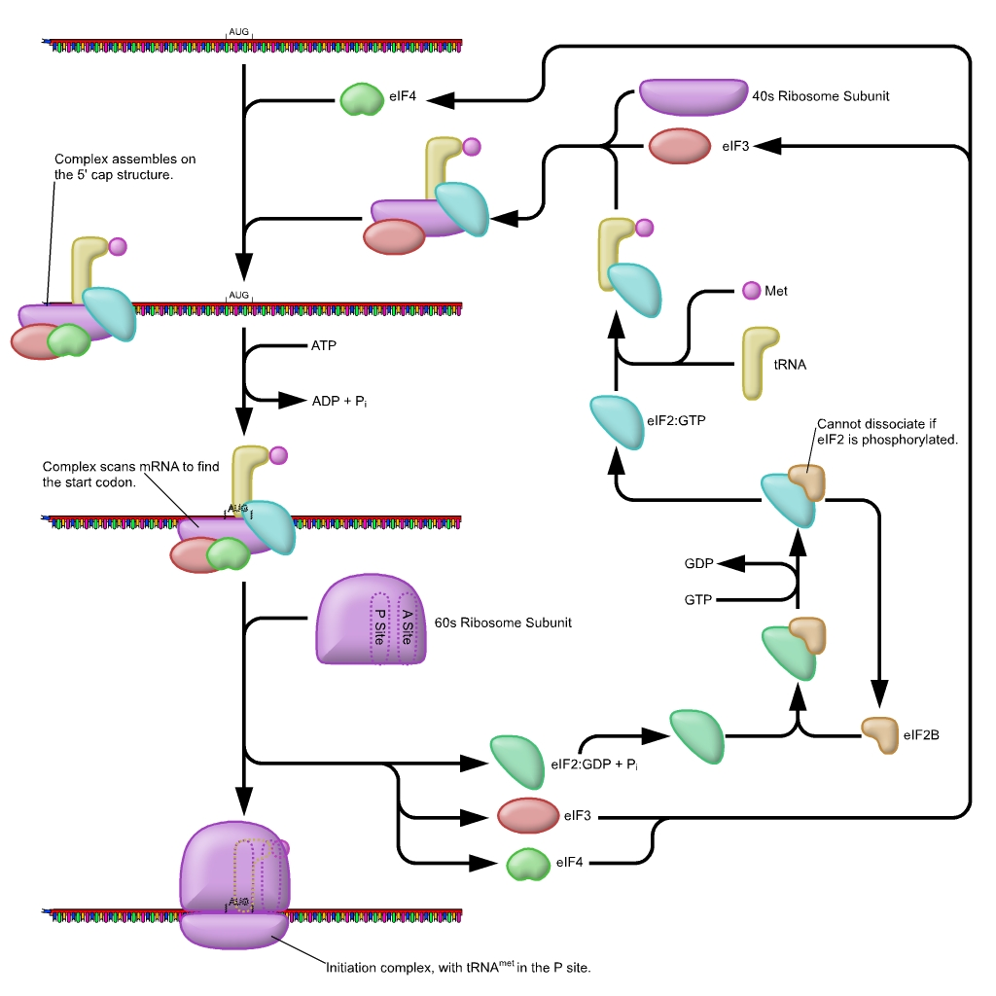
Tema 11. Traducción Iniciación
Initiation of protein synthesis in eukaryotes is similar to that in prokaryotes.
The order of events is different, and the number of accessory factors is greater.

Slide 11
Tema 11. Traducción Iniciación
The nontranslated 5’ leader is relatively short, usually <100 bases.

Slide 12
Tema 11. Traducción Iniciación
The nontranslated 3’ trailer is often rather long (100 - 1000 b).
By virtue of its location, the leader cannot be ignored during initiation, but the function for the trailer is less obvious.

Slide 13
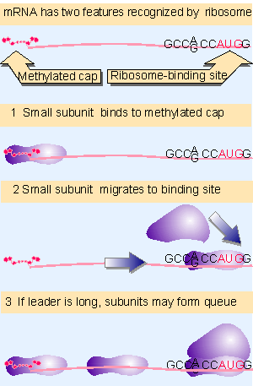
Tema 11. Traducción Scanning
The first feature to be recognized during translation of a eukaryotic mRNA is the methylated cap that marks the 5’ end.
Messengers whose caps have been removed are not translated efficiently.
Binding of 40S subunits to mRNA requires several initiation factors, including proteins that recognize the structure of the cap.

Slide 14
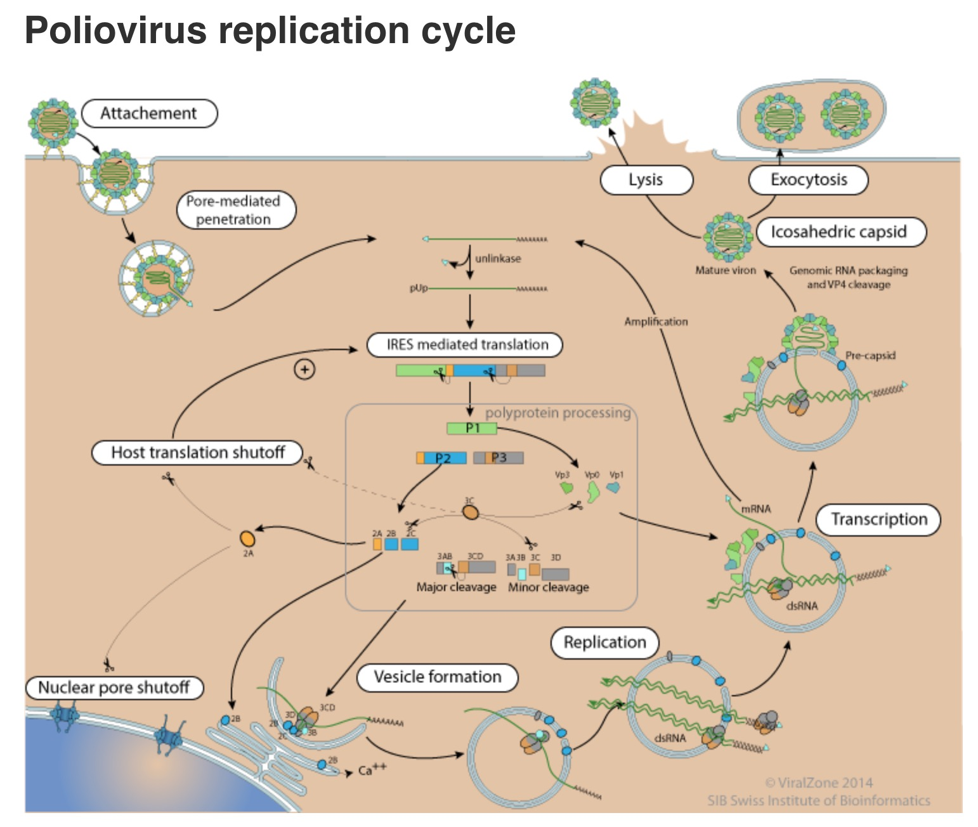
Tema 11. Traducción Cap detection
5’-caps are placed on all cellular or viral mRNAs and are essential for their translation in eukaryotic cytoplasm (but not for mitochondria).
The sole exception: poliovirus are not capped; only these exceptional viral mRNAs can be translated without caps.
Poliovirus infection inhibits the translation of host mRNAs.
This is accomplished by interfering with the cap binding proteins that are needed for initiation of cellular mRNAs, but that are superfluous for the noncapped poliovirus mRNA.

Slide 15
Tema 11. Traducción Iniciación
"scanning" model supposes that the 40S subunit initially recognizes the 5’ cap and then "migrates" along the mRNA.
In many mRNAs the cap and AUG are farther apart, in extreme cases ~1000 bases distant.
Yet the presence of the cap is still necessary for a stable complex to be formed at the initiation codon.

Slide 16
Tema 11. Traducción Iniciación
Scanning from the 5’ end is a linear process.

Slide 17
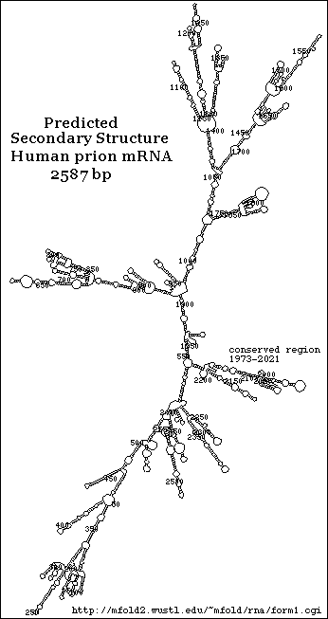
Tema 11. Traducción Iniciación
When 40S subunits scan the leader region, they melt secondary structure hairpins with stabilities above -30 kcal.
Hairpins of greater stability impede or prevent migration.

Slide 18
Tema 11. Traducción Iniciación
Migration stops when the 40S subunit encounters the AUG initiation codon.
Usually, although not always, the first AUG triplet sequence will be the initiation codon.
The AUG triplet by itself is not sufficient to halt migration; it is recognized efficiently as an initiation codon only when it is in the right context.
The optimal context consists of the sequence GCC^{A}_{G}CCAUGG “Kozak Consensus Sequence”

Slide 19
Tema 11. Traducción Iniciación
“Kozak Consensus Sequence” GCCAGCCAUGG
The purine (A or G) 3 bases before the AUG codon, and the G immediately following it, are the most important, and influence efficiency of translation by 10X ; the other bases have much smaller effects.

Slide 20
Tema 11. Traducción Iniciación
When the leader sequence is long, further 40S subunits can recognize the 5’ end before the first has left the initiation site, creating a queue of subunits proceeding along the leader to the initiation site.

Slide 21
Tema 11. Traducción Iniciación
The process of initiation in eukaryotes is analogous to that in E. coli.
Eukaryotic cells have more initiation factors than bacteria
The factors are named similarly to those in bacteria, given the prefix "e" to indicate their eukaryotic origin.

Slide 22
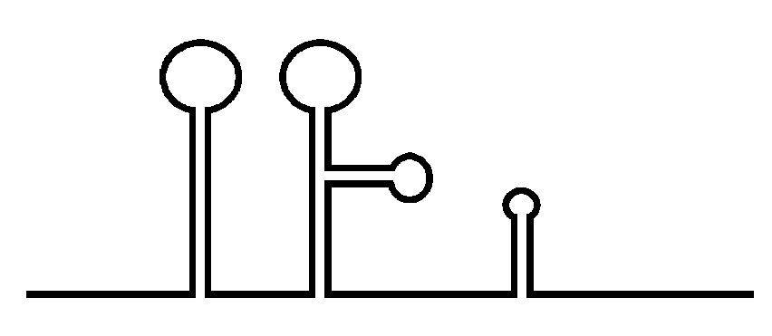
Tema 11. Traducción Iniciación
We have dealt with the process of initiation as though the ribosome-binding site is always freely available.
However, its availability may be impeded by secondary structure.
The recognition of mRNA requires several additional factors; an important part of their function is to remove any secondary structure in the mRNA.
AUG
3'
5'
m7G

Slide 23
Tema 11. Traducción Iniciación
The factor eIF4F is a protein complex that regulates key events in recruiting ribosomes to mRNA.
It is not clear whether it preassembles as a complex before binding to mRNA or whether the individual subunits are added individually.
It includes the cap-binding subunit eIF-4E, the RNA-dependent ATPase eIF-4A, and the "scaffolding" subunit eIF-4G.
eIF-4F
eIF-4A
eIF-4G
eIF-4E
AUG
3'
5'
m7G

Slide 24
Tema 11. Traducción Iniciación
1.- eIF-4E Recognizes the 5' Cap on mRNA.
2.- eIF-4G Recognizes eIF-4E bound to the 5' Cap on mRNA.
3.- eIF-4A Binds to eIF-4G and helps unwind immediate secondary structure (first 15 bases).
eIF-4F
eIF-4A
eIF-4G
eIF-4E
AUG
3'
5'
m7G

Slide 25
Tema 11. Traducción Iniciación
1.- eIF-4E Recognizes the 5' Cap on mRNA.
2.- eIF-4G Recognizes eIF-4E bound to the 5' Cap on mRNA.
3.- eIF-4A Binds to eIF-4G and helps unwind immediate secondary structure (first 15 bases).
eIF-4A
eIF-4G
eIF-4E
AUG
3'
5'
m7G

Slide 26
Tema 11. Traducción Iniciación
Meanwhile, eIF-1A & eIF-3 stabilize small subunits.
eIF-3 is a very large complex, with 8-10 subunits.
eIF-4A
40S
eIF-1A
eIF-4G
eIF-3
eIF-4E
AUG
3'
5'
m7G

Slide 27
Tema 11. Traducción Iniciación
M
Meanwhile, eIF-1A & eIF-3 stabilize small subunits.
eIF-3 is a very large complex, with 8-10 subunits. tRNAi^{Met} is bound by eIF-2 (ternary complex)
tRNAi^{Met}
eIF-2
eIF-4A
40S
eIF-1A
eIF-4G
eIF-3
eIF-4E
AUG
3'
5'
m7G

Slide 28
Tema 11. Traducción Iniciación
M
Ternary complex contains Met-tRNA_{i}, eIF2, and GTP.
The complex is formed in two stages.
1.- GTP binds to eIF-2 which increases the factor’s affinity for Met-tRNA_{i}
2.- Met-tRNA_{i} is then bound.
tRNAi^{Met}
eIF-2
eIF-4A
40S
eIF-1A
eIF-4G
eIF-3
eIF-4E
AUG
3'
5'
m7G

Slide 29
Tema 11. Traducción Iniciación
The reaction is independent of the presence of mRNA.
The Met-tRNA_{i} initiator must be present in order for the 40S subunit to bind to mRNA .
M
tRNAi^{Met}
eIF-2
eIF-4A
40S
eIF-1A
eIF-4G
eIF-3
eIF-4E
AUG
3'
5'
m7G

Slide 30
Tema 11. Traducción Iniciación
Ternary complex is stabilized with eIF-1 & -5
M
tRNAi^{Met}
eIF-5
eIF-2
eIF-1
eIF-4A
40S
eIF-1A
eIF-4G
eIF-3
eIF-4E
AUG
3'
5'
m7G

Slide 31
Tema 11. Traducción Iniciación
Ternary complex + eIF-5 eIF-1 are loaded unto small subunit.
M
tRNAi^{Met}
eIF-5
eIF-2
eIF-1
eIF-1A
eIF-3
eIF-4A
eIF-4G
eIF-4E
AUG
3'
5'
m7G

Slide 32
Tema 11. Traducción Iniciación
Small subunit is loaded unto eIF-4G/eIF-4A complex
eIF-4G binds to eIF-3 associated with the small ribosomal subunit.
This provides the means by which the 40S ribosomal subunit binds to eIF-4F.
M
tRNAi^{Met}
eIF-5
eIF-2
eIF-1
eIF-1A
eIF-3
eIF-4A
eIF-4G
eIF-4E
AUG
3'
5'
m7G

Slide 33
Tema 11. Traducción Iniciación
INITIATION COMPLEX
eIF-4A
M
eIF-4G
eIF-4E
AUG
3'
5'
m7G

Slide 34
Tema 11. Traducción Iniciación
eIF-4B is recruited to the initiation complex to denature further secondary structures.
eIF-4A
M
eIF-4G
eIF-4E
AUG
3'
5'
m7G
eIF-4B

Slide 35
Tema 11. Traducción Iniciación
Once all secondary structures have been melted the initiation complex “scans” for a start codon.
This process requires energy in the form of ATP
ADP + Pi
ATP
M
AUG
3'
5'
m7G

Slide 36
Tema 11. Traducción Iniciación
Once all secondary structures have been melted the initiation complex “scans” for a start codon.
This process requires energy in the form of ATP
ADP + Pi
ADP + Pi
M
ADP + Pi
AUG
3'
5'
m7G

Slide 37
Tema 11. Traducción Iniciación
Initiation in eukaryotes almost always uses AUG as the start codon.
Start codon recognition by ternary complex displaces eIF-2 by hydrolizing GTP to produce eIF-2-GDP + Pi.
eIF-2 removal necessary for 60S to join 40S.
eIF-2+GDP
Pi
M
AUG
3'
5'
m7G

Slide 38
Tema 11. Traducción Iniciación
eIF-6 is required to maintain large subunits in their dissociated state.
eIF-2, eIF-3 & eIF-6 are released when the large subunit joins the initiation complex (60S will not load otherwise).
60S
GTP
eIF-5B
eIF-6
GDP + Pi
M
AUG
3'
5'
m7G

Slide 39
Tema 11. Traducción Iniciación
This is mediated by eIF-5, which is a GTPase.
eIF-6
eIF-3
50S
GTP
eIF-5
GDP + Pi
M
AUG
3'
5'
m7G

Slide 40
Tema 11. Traducción Iniciación
All of the remaining factors are released when the complete 80S ribosome is formed.
eIF-6
eIF-3
M
AUG
3'
5'
m7G

Slide 41
Tema 11. Traducción tRNA iniciador
M
The initiator tRNA is a distinct species = tRNAiMet
Methionine not formylated.
Difference between the initiating and elongating Met-tRNAs lies solely in the tRNA moiety, with Met-tRNA_{i} used for initiation and Met-tRNA_{m} used for elongation.
tRNAi^{Met}
eIF-2

Slide 42
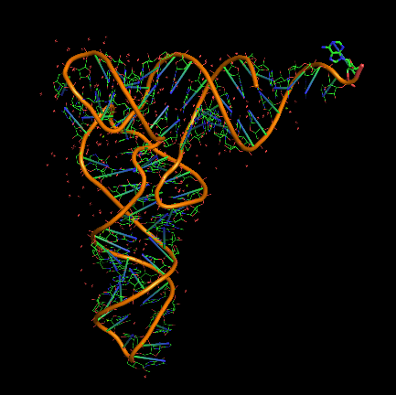
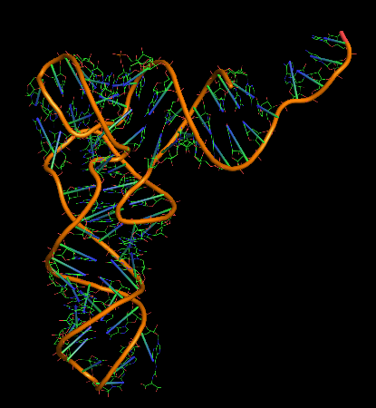
Tema 11. Traducción tRNA iniciador
Two unique features of the initiator tRNA_{i}^{Met} in yeast:
1.- it has an unusual tertiary structure

Slide 43
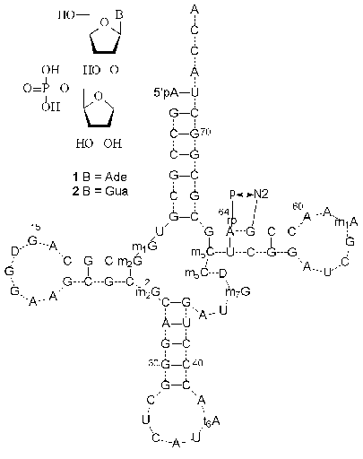
Tema 11. Traducción tRNA iniciador
Two unique features of the initiator tRNA_{i}^{Met} in yeast:
2.- it is modified by phosphorylation
of the 2' ribose position on base 64
(if this modification is prevented, the initiator can be used in elongation).
So the principle of a distinction between initiator and elongator Met-tRNAs is maintained in eukaryotes, but its structural basis is different from that in bacteria.

Slide 44
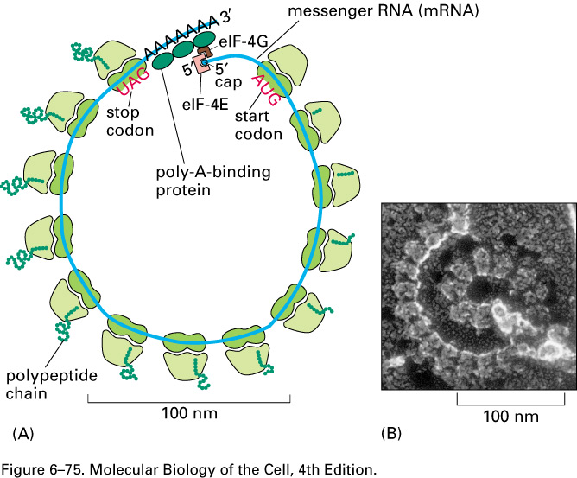
Tema 11. Traducción Iniciación
The presence of the 3' poly-A tail stimulates the formation of an initiation complex at the 5’ end.
The poly(A)-binding protein (PAB1P in yeast) is required for this effect.
Pab1p binds to eIF-4G, which in turn is bound to eIF4E.
This implies that the mRNA must (transiently) have a circular organization, with both the 5’ and 3’ ends held in this complex.
Go to Harvard video now!

Slide 45
Tema 11. Traducción Elongación
Once the complete ribosome is formed at the initiation codon, the stage is set for a cycle in which aminoacyl-tRNA enters the A site of a ribosome whose P site is occupied by tRNA_{i}^{Met}.
Any aminoacyl-tRNA except the initiator can enter the A site.
Its entry is mediated by an elongation factor (EF-Tu in bacteria eEF-1 or eEF-T in eukaryotes ).
The process is similar in eukaryotes & prokaryotes.
M
5'
3'
AUG

Slide 46
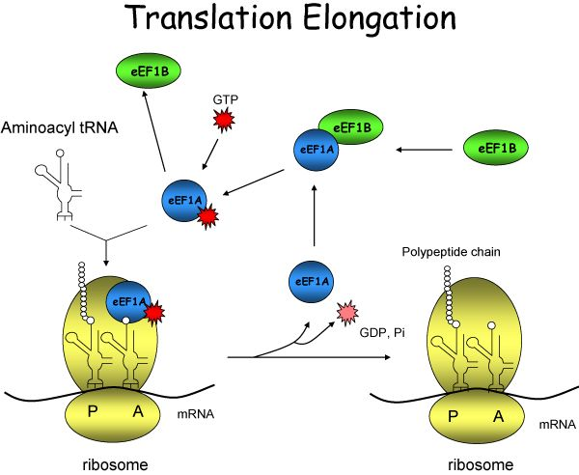
Tema 11. Traducción Elongación
In eukaryotes, eEF-1A is responsible for bringing aminoacyl-tRNA to the ribosome, in a reaction that involves cleavage of GTP.
It is homologous to its prokaryotic counterpart (EF-Tu).
It is regenerated by eEF-1B, an EF-Ts homologue.

Slide 47
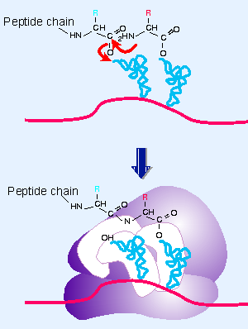
Tema 11. Traducción Elongación
The peptidyl transferase reaction involves elongating the polypeptide chain by transferring the polypeptide of the P-site-tRNA to the A-site-tRNA.
Peptidyl transferase is a function of the large (50S or 60S) ribosomal subunit.
The transferase is part of a ribosomal site close to the upper ends of both tRNAs.
Both rRNA and 50S subunit proteins are necessary for this activity.

Slide 48
Tema 11. Traducción Elongación
After transpeptidation, the ribosome must move (translocate) one codon towards 3'.
First the aminoacyl ends of the tRNAs (located in the 50S subunit) move into the new sites (while the anticodon ends remain bound to their codons in the 30S subunit).
At this stage, the tRNAs are effectively bound in hybrid sites, consisting of the 50S E/ 30S P and the 50S P/ 30S A sites.
1st
M
M
M
A
A
A
5'
3'
2nd

Slide 49
Tema 11. Traducción Elongación
Then movement is extended to the 30S subunits, so that the anticodon-codon pairing region finds itself in the right site.
1st
M
M
M
A
A
A
5'
3'
2nd

Slide 50
Tema 11. Traducción Elongación
Translocation expels the uncharged tRNA from the P site, so that the new peptidyl-tRNA can enter the A site.
In bacteria the discharged tRNA leaves the ribosome via another site, the E site.
In eukaryotes it is expelled directly into the cytosol.
1st
M
M
M
A
A
A
5'
3'
2nd

Slide 51
Tema 11. Traducción Elongación
Another model hypothesizes a dissociative movement of subunits
1st
M
M
M
A
A
A
5'
3'
2nd

Slide 52
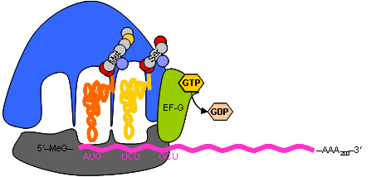
Tema 11. Traducción Elongación en procariotas
Translocation requires GTP and another elongation factor, eEF-2.
This factor is a major constituent of the cell; it is present at a level of ~1 copy per ribosome (20,000 molecules per cell).
Ribosomes cannot bind eEF-1A (EF-Tu in prokaryotes) and eEF-2 (EF-G in prokaryotes) simultaneously, it’s a two-step process!

Slide 53
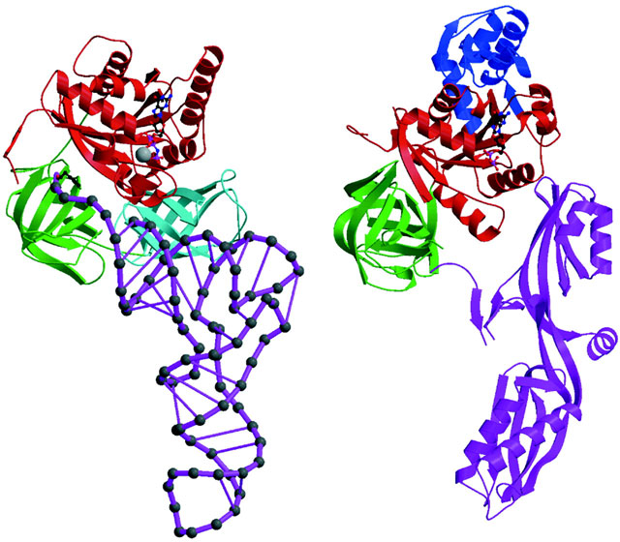
Tema 11. Traducción Elongación en procariotas
eEF-2 is a protein and not a special kind of tRNA.
Exhibit remarkable similarity to tRNA.
Convergent evolution !
eEF-2 mimics the overall structure of the aa complexed with tRNA in the ternary complex.
This creates the immediate assumption that they compete for the same binding site (presumably in the vicinity of the A site).
ternary complex of aminoacyl-tRNA:EF-Tu:GDP
eEF-2.

Slide 54
Tema 11. Traducción Elongación en eucariotas
EF-G binds to the ribosome to sponsor translocation; and then is released following ribosome movement.
The hydrolysis of GTP causes a change in the structure of EF-G, which in turn forces a change in the ribosome structure.
eEF-2 :GDP + Pi
M
A
M
M
A
A
eEF-2:GTP
5'
3'

Slide 55
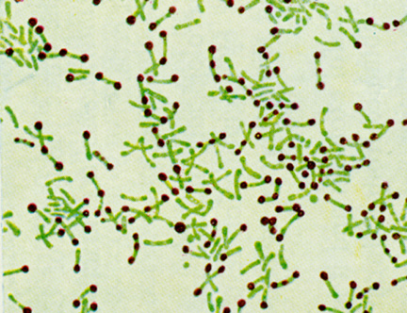
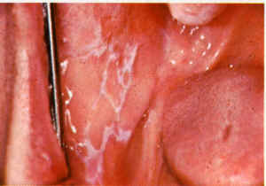
Tema 11. Traducción Elongación y antibióticos
The steroid antibiotic fusidic acid "jams" the ribosome in its post-translocation state.
Fusidic acid stabilizes the ribosome:eEF-2:GDP complex, so that eEF-2 and GDP remain on the ribosome instead of being released.
No further amino acids can be added to the chain.
Use as antibiotic!
Contrarily,
eEF-2 is very susceptible to diphtheria toxin.
EF-G (the prokaryote version) is not.

Slide 56
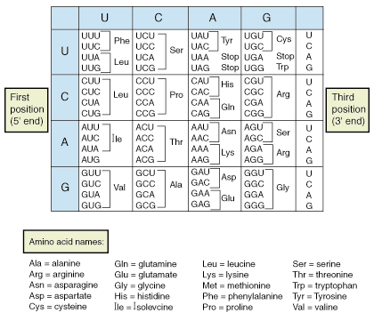
Tema 11. Traducción Terminación
Only 61 triplets are assigned to amino acids.
The other three triplets are termination codons (or stop codons).
UAG = amber codon
UGA = opal codon
UAA = ochre codon
In bacteria UAA is the most commonly used termination codon in eukaryotes its UAG.
There appear to be more errors reading UGA, which result in the continuation of protein synthesis until another termination codon is encountered.

Slide 57
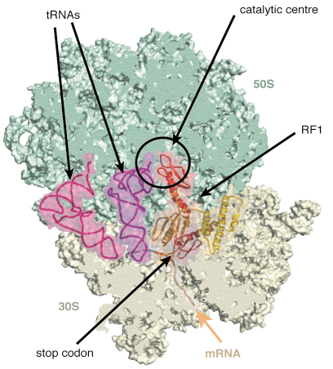
Tema 11. Traducción Terminación
In E. coli two related proteins catalyze termination.
They are called release factors (RF), and are specific for different sequences.
RF-1 recognizes UAA and UAG.
RF-2 recognizes UGA and UAA.
The factors act at the ribosomal A site and require polypeptidyl-tRNA in the P site.
The release factors are present at much lower levels than initiation or elongation factors;~600 molecules of each per cell (1 RF per 10 ribosomes).

Slide 58
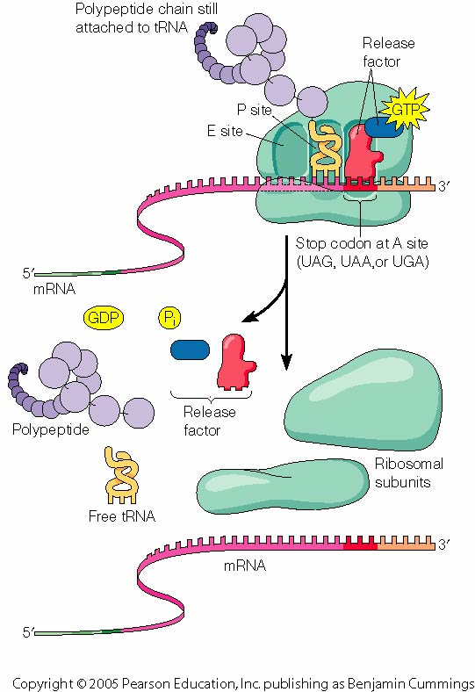
Tema 11. Traducción Terminación
RF1 and RF2 recognize the termination codons and activate the ribosome to hydrolyze the peptidyl tRNA.
Reaction analogous to the usual peptidyl transfer, except that the acceptor is H2O instead of aminoacyl-tRNA.
RF1 or RF2 are released from the ribosome by RF-3, which is a GTP-binding protein related to EF-G.
RF3 resembles the GTP-binding domains of EF-Tu and EF-G, and RF1/2 resemble the C-terminal of EF-G, which mimics tRNA.

Slide 59
Tema 11. Traducción Terminación
Two stages are involved in ending translation.
The termination reaction itself involves release of the protein chain from the last tRNA.
The post-termination reaction involves release of the tRNA and mRNA, and dissociation of the ribosome into its subunits.
None of the termination codons is represented by a tRNA, they are recognized directly by protein factors!

Slide 60
Tema 11. Traducción PKR: dsRNA and stress sensor
Stress signals induced by viral infection arrest translation of both cellular and viral mRNAs.
In order to inhibit viral replication.
Host PKR activated by dsRNA, dimerizes, autophosphorylates and phosphorylates eIF2-α translation initiation factor.
eIF2 phosphorylation arrests translation.
Viruses have evolved different strategies to avoid complete arrest of translation.
1.- Directly modulating PKR activity
2.- Inhibiting phosphorylation of eIF2-α

