Slide 1
Tema 8
mRNA, tRNA y rRNA
CA García Sepúlveda MD PhD
Last updated Jan 2019
Laboratorio de Genómica Viral y Humana Facultad de Medicina, Universidad Autónoma de San Luis Potosí

Slide 2
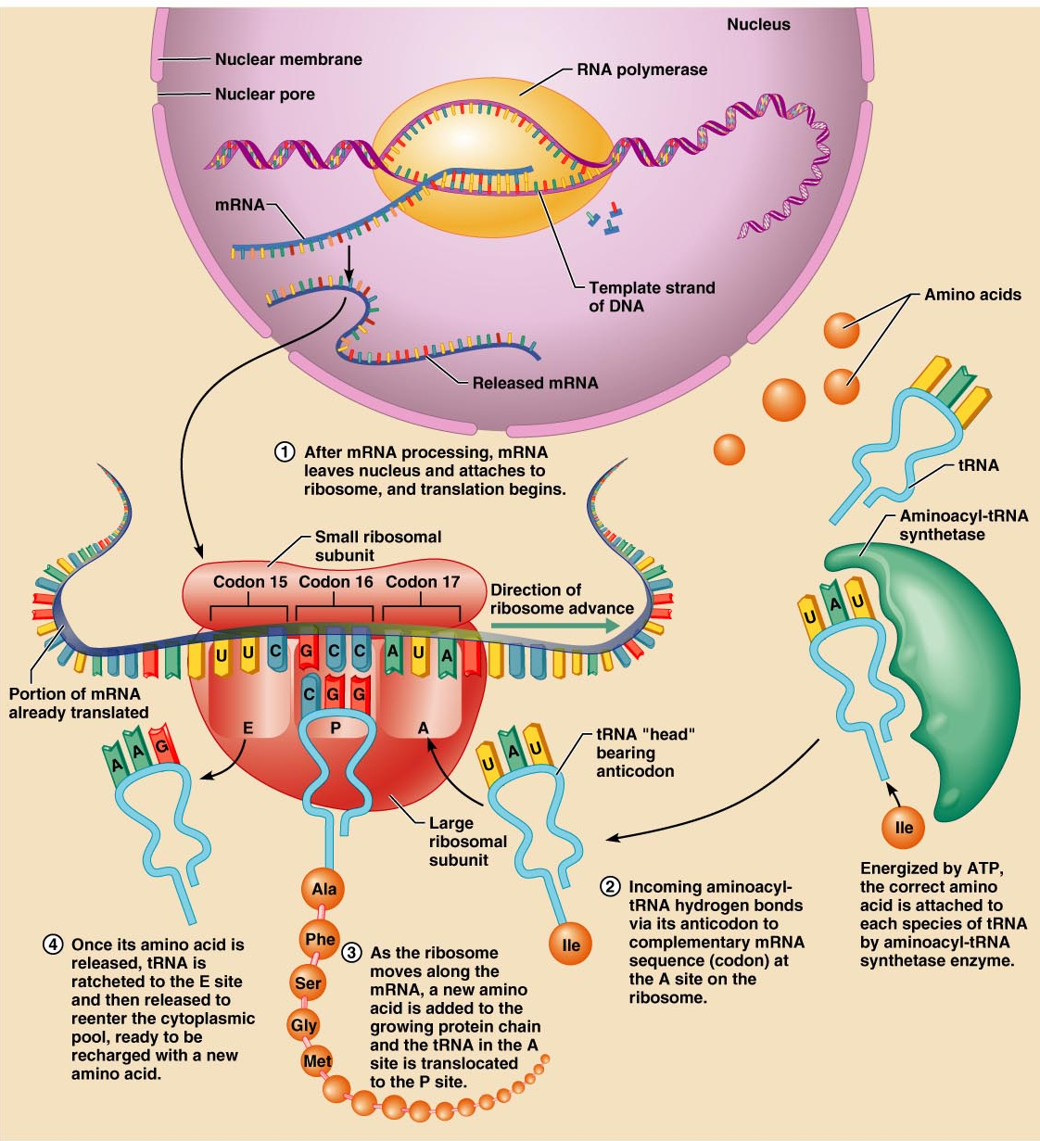
Tema 8. RNA Introducción
mRNAs are single stranded RNA molecules
They are copied from the TEMPLATE strand of the gene, to give the SENSE strand in RNA
They are transcribed from the 5’ to the 3’ end
They are translated from the 5’ to the 3’ end

Slide 3
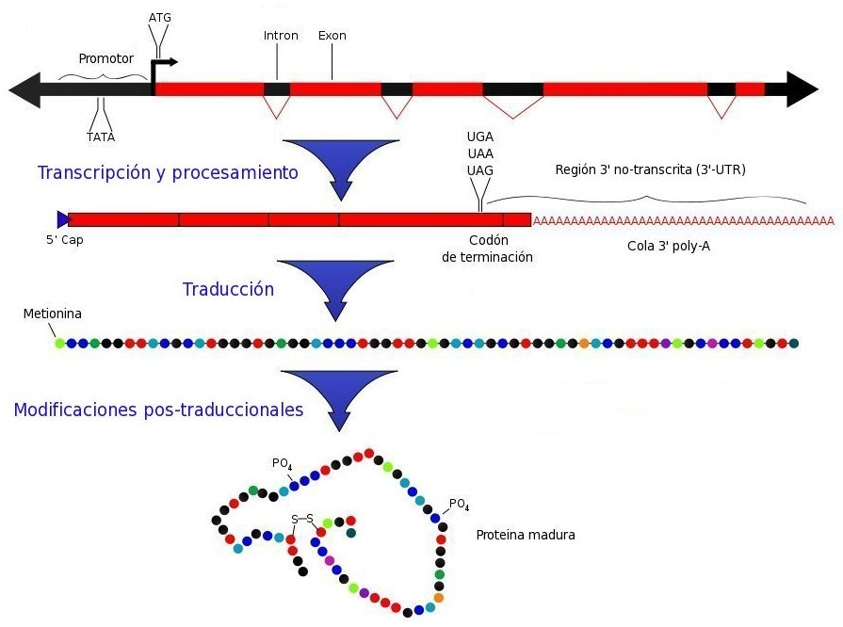
Tema 8. RNA mRNA
They encode only one peptide(each) in eukaryotes (monocistronic).
Polyproteins are observed in eukaryotic viruses, but these are a single translation product, cleaved into separate proteins after translation.

Slide 4
Tema 8. RNA mRNA
Catalysed by RNA Polymerase II
Stages: initiation, elongation and termination
Initiation is at the Promoter sequence
Regulation of gene expression is at the initiation stage
Transcription factors binding to the promoter regulate the rate of initiation of RNA Polymerase

Slide 5
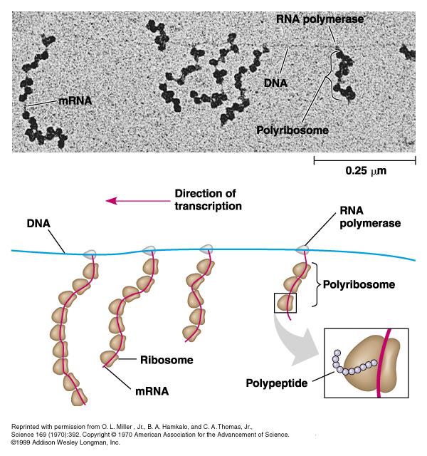
Tema 8. RNA mRNA - Prokaryotes
Transcription of protein coding RNA
5’ and 3’ ends are unmodified
Ribosomes bind at ribosome binding site (do not require a free 5’ end)
Can contain many open reading frames (ORFs)
Translated 5’ → 3
Transcribed and translated together

Slide 6
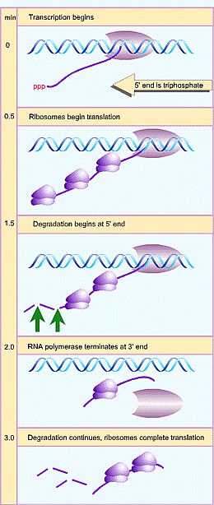
Tema 8. RNA mRNA life cycle
mRNA is synthesised by RNA Polymerase
Translated (once or many times)
Degraded by RNAses
Steady state level depends on the rates of both synthesis and degradation
Production  Degradation

Slide 7
Tema 8. RNA mRNA - Eukaryotes
Linear RNA structure
5’ and 3’ ends are modified
5’ GpppG cap
3’ poly A tail
Transcribed, spliced, capped, poly Adenylated in the nucleus, exported to the cytoplasm

Slide 8
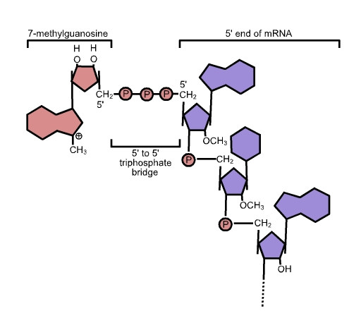
Tema 8. RNA mRNA – 5’ capping
Guanine nucleotide connected to the mRNA via an unusual 5' to 5' triphosphate linkage.
This guanosine is methylated on C7 (7-methylguanosine) or m7G.
Methylation of the 2’-OH of the first 3 ribose sugars.
Functionally the 5’-cap looks like the 3' end of an RNA molecule.
Offers resistance to 5' exonucleases.

Slide 9
Tema 8. RNA mRNA – 5’ capping
The 5' cap is a specially altered nucleotide end to the 5' end of precursor messenger RNA and, as a special exception, caliciviruses (Norwalk).
Acute epidemic gastroenteritis (nursery, hospital and cruises).

Slide 10
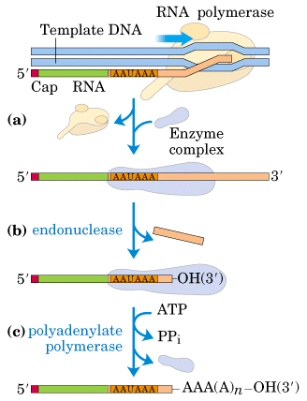
Tema 8. RNA mRNA – 3’ polyadenylation
Covalent linkage of a poly(A) tail to most mRNA (eukaryotic).
Poly-A tail protects the mRNA from exonucleases and important for transcription termination, for export of the mRNA from the nucleus, and for translation.
Some prokaryotic mRNAs also are polyadenylated.
Poly-A signal is transcribed, mRNA is cleaved (endonuclease) in a special site (AAUAAA) then 50 to 250 adenine residues are added.
This reaction is catalyzed by polyadenylate polymerase.

Slide 11
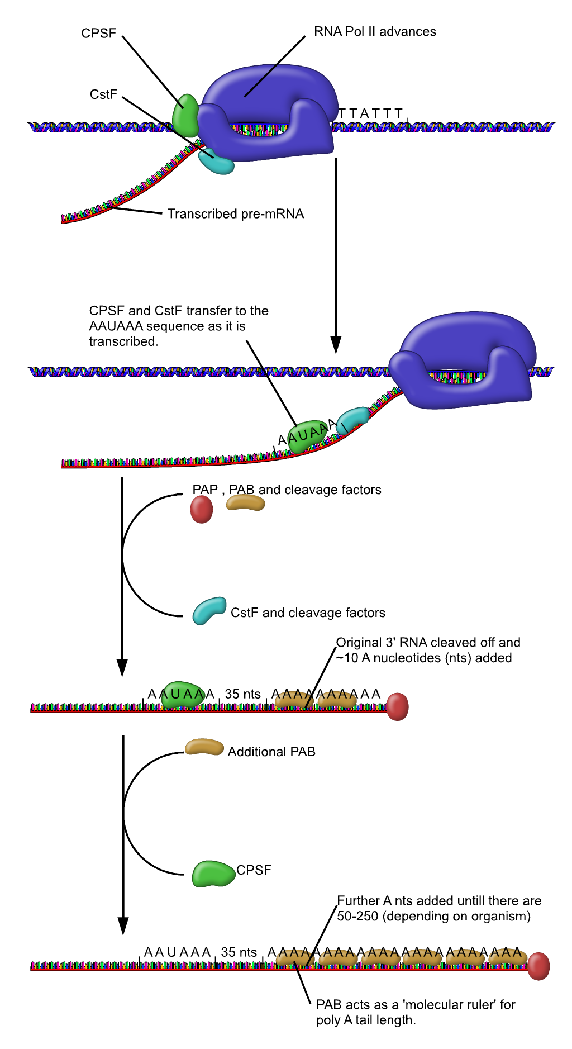
Tema 8. RNA mRNA – 3’ polyadenylation
Cleavage and Polyadenylation Specificity Factor (CPSF)
Cleavage Stimulation Factor (CstF) bound to the rear of the RNA polymerase II.
CPSF & CstF transfer to the pre-mRNA, CPSF binds AAUAAA sequence while CstF binds the GU or U rich sequence.
CPSF & CstF promote cleavage 35 nt after AAUAAA sequence.
Polyadenylate Polymerase (PAP) immediately starts adding 100 to 250 Adenines.
Nuclear Polyadenylate Binding Protein (PABPN1) immediately binds to the new poly-A tag and acts as a molecular ruler.

Slide 12
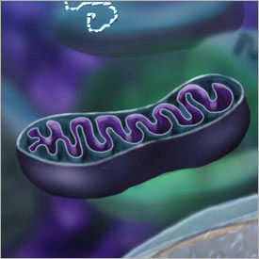
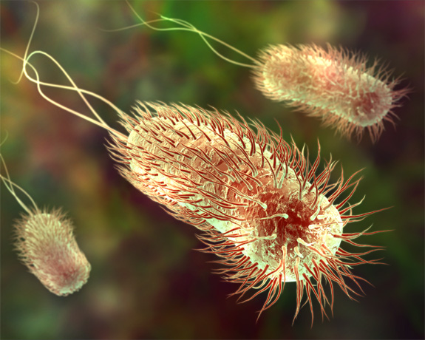
Tema 8. RNA Endosymbionts
Single stranded
Polycistronic (many ORFs)
Unmodified 5’ and 3’ ends
Transcribed and translated together
Show similarity to prokaryote genes and transcripts

Slide 13
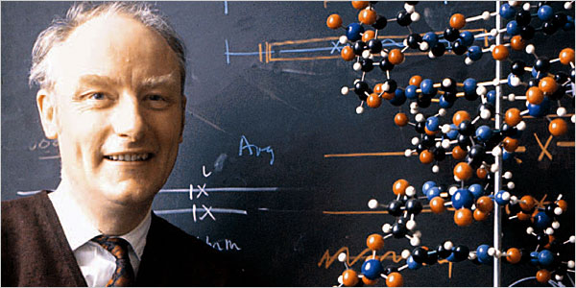
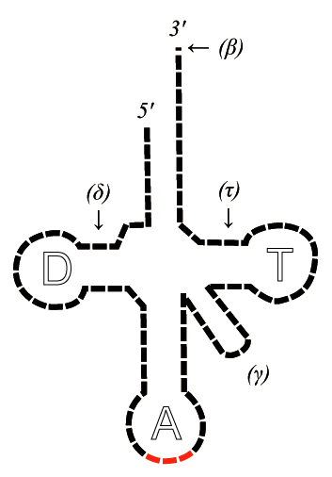
Tema 8. RNA tRNA
tRNA first hypothesized by Francis Crick.
Small RNA chain that transfers a specific amino acid to a growing polypeptide chain in the ribosome
Has a 3' terminal site for amino acids (whose linkage depends on aminoacyl tRNA synthetase).
Contains a three base region called the anticodon that complements the codon on the mRNA.
Each type of tRNA molecule can be attached to only one type of amino acid.
tRNA molecules bearing different anticodons may also carry the same amino acid (degenerecy).
tRNA
anticodon
codon
mRNA

Slide 14
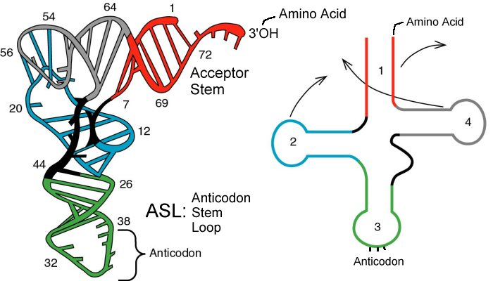
Tema 8. RNA tRNA
tRNA has primary structure (sequence), secondary structure (cloverleaf), and tertiary structure (L-shape).
Small RNAs 75 - 85 bases in length
Highly conserved secondary and tertiary structures
Each class of tRNA charged with a single amino acid
Each tRNA has a specific trinucleotide anti-codon for mRNA recognition
Conservation of structure and function in prokaryotes and eukaryotes

Slide 15
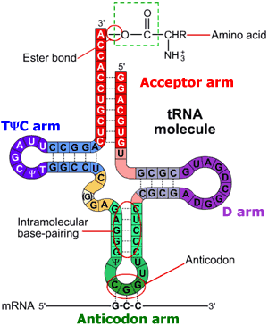
Tema 8. RNA tRNA
The 5'-terminal phosphate group.
The acceptor stem (7bp) composed by the 5'-terminus base paired to the 3'-terminus (contains non-Watson-Crick base pairs).
The CCA tail is at the 3' end of the tRNA molecule (important for the recognition of tRNA by enzymes critical in translation). NOTE: In prokaryotes, the CCA sequence is transcribed. In eukaryotes, the CCA sequence is added.
The D arm (18bp) ends in a loop which contains dihydrouridine.
The anticodon arm (ca17bp) contains the anticodon.
The T arm (17bp) contains TΨC sequence (Ψ = pseudouridine).
Modified (methylated) bases occur in several positions outside the anticodon. First anticodon base sometimes modified to inosine or Ψ).
tRNA is an ADAPtor molecule

Slide 16
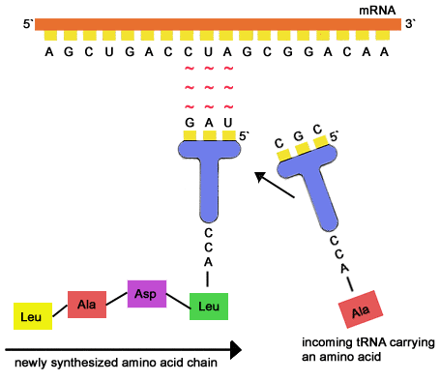
Tema 8. RNA tRNA
An anticodon is a unit made up of three nucleotides that complement the three bases of the codon on the mRNA.
Different base triplets (codons) in mRNA code for different amino acids.
One aminoacid can be encoded by several codons (degeneracy)

Slide 17
Tema 8. RNA tRNA
Organisms have varying amounts of tRNA genes.
C. elegans has 29,647 genes of which 620 code for tRNA (2%).
Saccharomyces cerevisiae has 275 tRNA genes in its genome.
In the human genome there are:
4,421 non-coding RNA genes (which include tRNA genes).
22 mitochondrial tRNA genes
497 nuclear genes encoding cytoplasmic tRNA molecules and
324 tRNA-derived putative pseudogenes.
Cytoplasmic tRNA genes are grouped into 49 families
tRNA genes are found on all chromosomes, except 22 and Y.
High clustering on 6p and 1.
tRNA molecules are transcribed (in eukaryotic cells) by RNA polymerase III

Slide 18
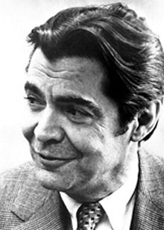
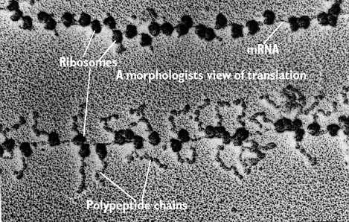
Tema 8. RNA rRNA
First observed in the mid-1950s by Romanian cell biologist George Palade using an electron microscope as dense particles or granules
Nobel in Physiology, 1974.
Prokaryotic ribosomes are smaller than most of the eukaryotes.
The ribosomes in eukaryote mitochondria resemble those in bacteria.
The function of ribosomes is the assembly of proteins (translation).
Ribosomes catalyze the assembly of individual
amino acids into polypeptide chains.
They use mRNA as a template to join a correct
sequence of amino acids.
This reaction uses adapters called tRNA.

Slide 19
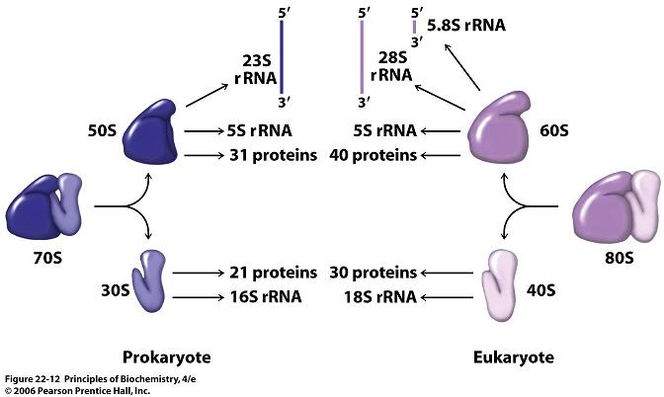
Tema 8. RNA rRNA
The basic form of the ribosome is conserved, but there are appreciable variations in the overall size and proportions of RNA and protein in the ribosomes of bacteria, eukaryotic cytoplasm, and organelles.
Al ribosomes consists of two subunits, each of which contains a major rRNA and a number of small proteins.
The large subunit may also contain smaller RNAs.

Slide 20
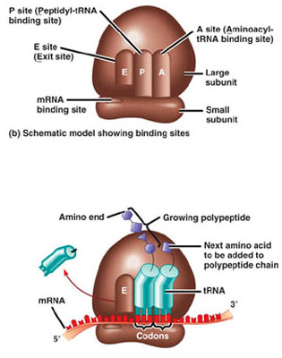
Tema 8. RNA rRNA
Prokaryote ribosomes have three binding sites for tRNA molecules: the A, P and E sites.
A= aminoacyl-tRNA site
P= Peptidyl-tRNA site
E= Egress site

Slide 21
Tema 8. RNA rRNA
Prokaryote ribosomes have three binding sites for tRNA molecules: the A, P and E sites.
A= aminoacyl-tRNA site
P= Peptidyl-tRNA site
E= Egress site
During translation the A site binds an incoming aminoacyl-tRNA as directed by the codon currently occupying this site.
This codon specifies the next amino acid to be added to the growing peptide chain.
The A site is only working after the first aminoacyl-tRNA has attached to the P site.

Slide 22
Tema 8. RNA rRNA
Prokaryote ribosomes have three binding sites for tRNA molecules: the A, P and E sites.
A= aminoacyl-tRNA site
P= Peptidyl-tRNA site
E= Egress site
The P-site codon is occupied by peptdyl-tRNA (a tRNA with multiple amino acids attached).
The P site is actually the first to bind to aminoacyl tRNA.
This tRNA in the P site carries the chain of amino acids that has already been synthesized.

Slide 23
Tema 8. RNA rRNA
Prokaryote ribosomes have three binding sites for tRNA molecules: the A, P and E sites.
A= aminoacyl-tRNA site
P= Peptidyl-tRNA site
E= Egress site
The E site is occupied by the empty tRNA as it is about to exit the ribosome.

Slide 24
Tema 8. RNA rRNA
Prokaryote and eukaryote ribsome differences lie outside of functional parts (A, P & E sites) and therefore “redundant insertions”.
The differences are exploited by pharmaceuticals to create antibiotics that destroy bacteria without harming the cells of the infected person.
Even though mitochondria possess similar ribosomes they are not affected by these antibiotics (complex double membrane).
Antibiotics such as macrolides, aminoglycosides and others:
anisomycin
cycloheximide
chloramphenicol
tetracycline
streptomycin
erythromycin
puromycin, etc.

Slide 25
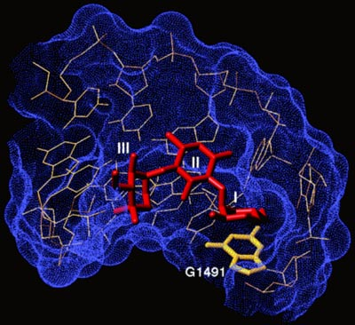
Tema 8. RNA rRNA
Structure of the antibiotic gentamicin C1a bound to its rRNA target.
Gentamicin, an aminoglycoside antibiotic, binds within the major groove of the RNA, which is located in the decoding site of the bacterial ribosome.
Aminoglycosides cause misreading of the genetic code.
Binding of the drug causes a conformational change in ribosomal RNA that disrupts high-fidelity reading of the genetic code.

Slide 26
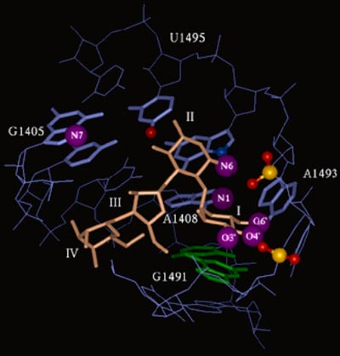
Tema 8. RNA rRNA
Structure of the aminoglycoside paromomycin bound to the bacterial rRNA decoding site.
The sites that lead to resistance are highlighted with purple spheres.
The N7 methylation at G1405 only causes resistance to aminoglycosides like gentamicin that contact this position directly.

