Slide 1
Tema 9
miRNA y siRNA
CA García Sepúlveda MD PhD
Last updated Jan 2019
Laboratorio de Genómica Viral y Humana Facultad de Medicina, Universidad Autónoma de San Luis Potosí

Slide 2
Tema 9. miRNA & siRNA Introducción
Molecule | Function
mRNAs | messenger RNAs, code for proteins
rRNAs | ribosomal RNAs, form the basic structure of the ribosome and catalyze protein synthesis
tRNAs | transfer RNAs, central to protein synthesis as adaptors between mRNA and amino acids
snRNAs | small nuclear RNAs, function in a variety of nuclear processes, including the splicing of pre-mRNA
snoRNAs | small nucleolar RNAs, used to process and chemically modify rRNAs
scaRNAs | small cajal RNAs, used to modify snoRNAs and snRNAs
miRNAs | microRNAs, regulate gene expression typically by blocking translation of selective mRNAs
siRNAs | small interfering RNAs, turn off gene expression by directing degradation of selective mRNAs and the establishment of compact chromatin structures
Other non-coding RNAs | function in diverse cell processes, including telomere synthesis, X-chromosome inactivation, and the transport of proteins into the ER

Slide 3
Tema 9. miRNA & siRNA Discovery of RNAi
Discovery of RNAi through observations of transcriptional inhibition by antisense RNA expressed in transgenic plants.
Reports of unexpected outcomes in experiments performed by plant scientists in the United States and the Netherlands in the early 1990s.
In an attempt to alter flower colors in petunias, researchers introduced additional copies of a gene encoding chalcone synthase, a key enzyme for flower pigmentation.
The overexpressed gene was expected to result in darker flowers, but instead produced less pigmented, fully or partially white flowers, indicating that the activity of chalcone synthase had been altered.
Further investigation indicated that downregulation was due to post-transcriptional inhibition of gene expression due to increased mRNA degradation.
This phenomenon was called co-suppression of gene expression, but the molecular mechanism remained unknown.

Slide 4
Tema 9. miRNA & siRNA Introducción
RNA interference (RNAi) is a process within living cells that moderates the activity of their genes.
Previously known as co-suppression, post transcriptional gene silencing (PTGS) and quelling.
In 2006, Andrew Fire and Craig C. Mello shared the Nobel Prize in Physiology or Medicine for their work on RNAi in the nematode worm C. elegans.
Two types of RNA molecules involved:
- microRNA (miRNA)
- small interfering RNA (siRNA)
They bind to other specific mRNAs and modulate their activity.
RNA interference has played an important role in defending cells against parasitic nucleotide sequences – viruses and transposons – but also in directing development as well as gene expression in general.

Slide 5
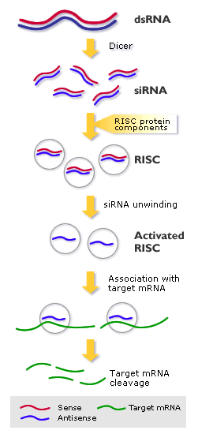
Tema 9. miRNA & siRNA siRNA (Exogenous dsRNA molecules)
RNAi is an RNA-dependent gene silencing process controlled by the RNA-induced silencing complex (RISC)
Initiated by short dsRNA molecules in a cell's cytoplasm.
dsRNAs are cleaved by Dicer into short fragments (~20 bp, siRNAs).
siRNA is unwound to form 2 ssRNAs (passenger and guide strand).
Passenger strand is degraded (red); guide strand (blue) is incorporated into RISC (thus, activated RISC).
Best known outcome is post-transcriptional gene silencing.
Guide strand pairs with a complementary sequence in a mRNA (green), inducing Argonaute (catalytic component of the RISC) cleavage of mRNA.
In some organisms, this process is known to spread systemically, despite the initially limited molar concentrations of siRNA.

Slide 6
Tema 9. miRNA & siRNA miRNA Endogenous RNA silencing
miRNAs are genomically encoded non-coding RNAs that regulate gene expression, particularly during development.
Mature miRNAs are similar to siRNAs produced from exogenous dsRNA but undergo post-transcriptional modification.
miRNA’s are expressed from longer RNA-coding gene as a primary transcript (pri-miRNA) which is processed within the cell nucleus to a 70 bp stem-loop structure (pre-miRNA) by the microprocessor complex (RNase III Drosha and dsRNA binding protein DGCR8).
The dsRNA molecule is bound and cleaved by Dicer to produce the mature miRNA molecule that can be integrated into the RISC complex; thus, miRNA and siRNA share the same cellular machinery downstream of their initial processing.
miRNAs typically inhibit the translation of many different mRNAs with similar sequences. In contrast, siRNAs typically inhibit only a single, specific target.

Slide 7
Tema 9. miRNA & siRNA miRNA Endogenous RNA silencing

Slide 8
Tema 9. miRNA & siRNA miRNA and siRNA
https://www.youtube.com/watch?v=5YsTW5i0Xro

Slide 9
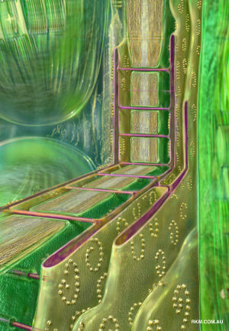
Tema 9. miRNA & siRNA Inheritable and systemic silencing
Organisms vary in their ability to take up foreign dsRNA and use it in the RNAi pathway.
The effects of RNA interference can be both systemic and heritable in plants and C. elegans, although not in Drosophila or mammals.
In plants, RNAi is thought to propagate by the transfer of siRNAs between cells through plasmodesmata (channels in the cell walls that enable communication and transport).
The heritability comes from methylation of promoters targeted by RNAi; the new methylation pattern is copied in each new generation of the cell.
In plants, miRNAs are usually perfectly complementary to their target genes and induce direct mRNA cleavage by RISC.
In animals miRNAs tend to be more divergent in sequence and induce translational repression by inhibiting the interactions of translation initiation factors with the messenger RNA's polyadenine tail.

Slide 10
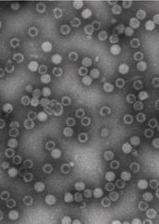
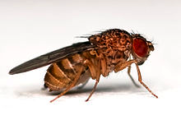
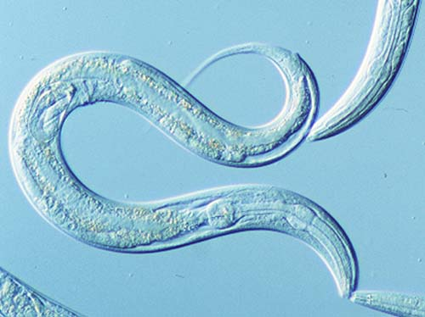
Tema 9. miRNA & siRNA Biological functions - Immunity
In both juvenile and adult Drosophila, RNA interference is important in antiviral innate immunity and is active against pathogens such as Drosophila X virus.
A similar role in immunity may operate in C. elegans, as argonaute proteins are upregulated in response to viruses.
The role of RNA interference in mammalian innate immunity is poorly understood, and relatively little data is available.
However, the existence of viruses that encode genes able to suppress the RNAi response in mammalian cells may be evidence in favour of an RNAi-dependent mammalian immune response.

Slide 11
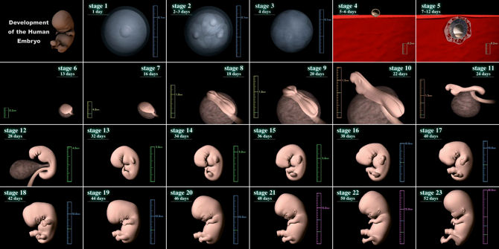
Tema 9. miRNA & siRNA Biological functions – Gene regulation
Endogenously expressed miRNAs, including both intronic and intergenic miRNAs, are most important in translational repression and in timing of morphogenesis and the maintenance of undifferentiated or incompletely differentiated cell types such as stem cells.
The role of endogenously expressed miRNA in downregulating gene expression was first described in C. elegans in 1993.
In plants, the majority of genes regulated by miRNAs are transcription factors.
In many organisms, including humans, miRNAs have also been linked to the formation of tumors and dysregulation of the cell cycle. Here, miRNAs can function as both oncogenes and tumor suppressors.
RNA sequences (siRNA and miRNA) that are complementary to parts of a promoter can increase gene transcription, a phenomenon dubbed RNA activation.

Slide 12
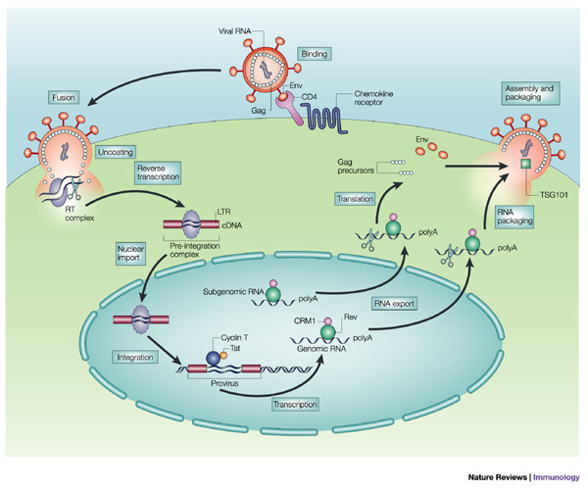
Tema 9. miRNA & siRNA Medical applications
It is difficult to introduce long dsRNA strands into mammalian cells due to the interferon response, the use of siRNA mimics has been more successful.
First applications to reach clinical trials were: the treatment of macular degeneration and respiratory syncytial virus,
RNAi has also been shown to be effective in the reversal of induced liver failure in mouse models.
Other proposed clinical uses center on antiviral therapies:
- HSV type 2
- knockdown of host HIV receptors
- silencing of HIV, HAV,HBV and flu genes
- inhibition of measles viral replication.
Viruses like HIV-1 are particularly difficult targets for RNAi-attack because they are escape-prone, which requires combinatorial RNAi strategies to prevent viral escape.

