Slide 1
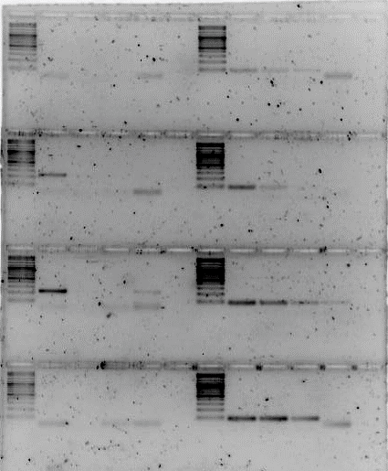
CAGS-2023-JUN-03A: Tm gradient for SEOV and SNV oligos using SEOV and SNV artificial gene serial dilutions of different Logs, respectively.
SNV Oligos with Clade 1 (SNV reference sequence) artificial gene
SEOV Oligos with SEOV reference sequence artificial gene
Log⁷ Log⁶ Log⁵ Log⁴
Column 12
Tm 61°C
Column 9
Tm 59°C
Column 6
Tm 56°C
Column 4
Tm 53°C
3% agarose in TAE, 120 VDC for 1.5 hrs, loading 15 uL (12.5 uL PCR + 5 uL OLB) with 5 uL MWM, Maxygene cycler #1

