Slide 1
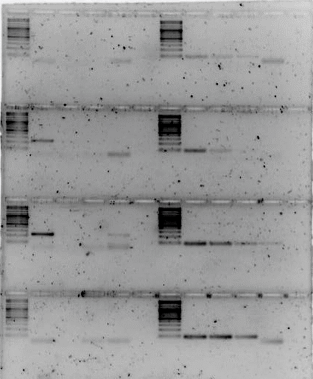
CAGS-2023-JUN-03A: Tm gradient for SEOV and SNV oligos using SEOV and SNV artificial gene serial dilutions of different Logs, respectively.
SNV Oligos with Clade 1 (SNV reference sequence) artificial gene
SEOV Oligos with SEOV reference sequence artificial gene
Log⁷ Log⁶ Log⁵ Log⁴
Column 12
Tm 61°C
Column 9
Tm 59°C
Column 6
Tm 56°C
Column 4
Tm 53°C
3% agarose in TAE, 120 VDC for 1.5 hrs, loading 15 uL (12.5 uL PCR + 5 uL OLB) with 5 uL MWM, Maxygene cycler #1

Slide 2
CAGS-2023-JUN-03A: Tm gradient for SEOV and SNV oligos using SEOV and SNV artificial gene serial dilutions of different Logs, respectively.
SNV Oligos with Clade 1 (SNV reference sequence) artificial gene
SEOV Oligos with SEOV reference sequence artificial gene
Mosq 1
Mosq 2
Mosq 3
Mosq 4
AMMH
Rx1
Rx2
MVP
Tm 49°C
Tm 51°C
CAGS
Tm 49°C
Tm 51°C
3% agarose in TAE, 90 VDC for 1.5 hrs, 40 VDC for 50 min, loading 25 uL (25 uL PCR + 5 uL OLB) with 6 uL MWM, MiniAmp Plus 1 and 2 (CAGS & MVP), MiniAmp Plus 3 (AMMH).

